Slide 1




Introduction to Causal Inference for Software Engineering
A 90-minute hands-on tutorial
Julien Siebert · Julian Frattini · Hans-Martin Heyn · Roberto Pietrantuono
FSE 2026 · Montréal · 5–9 July 2026
1

Slide 2
Section 4
Causal Models as Requirements Engineering Activity
FSE 2026 · Montréal · 5–9 July 2026
Causal Models as RE activity
2

Slide 3
What is the problem?
RE struggles to translate high-level requirements into data needs (Ahmad et al., 2023; Alves et al., 2023; Pei et al., 2022).
One reason for this under specification is that operational context is often implicitly assumed in the data collection (Mitchell et al., 2021).
This leads to brittle models that lack robustness (D'Amour et al., 2022).
Assumptions affecting the data selection should be made explicit and testable!
FSE 2026 · Montréal · 5–9 July 2026
Causal Models as RE activity
3

Slide 4
The vision of including prior knowledge about causality
Derive data and model requirements from prior knowledge about the operational context.
Enable documentation of these prior assumptions.
Allow for a systematic determination of testable conditions.
Use of causal modelling as a Requirement Engineering activity.
FSE 2026 · Montréal · 5–9 July 2026
Causal Models as RE activity
3

Slide 5
Causal models are a formal representation of prior knowledge
Graphical causal models are directed acyclic graphs (DAGs) that represent causal relationships between variables.
They visualise and reason systematically about causal structures of a given problem in each environment.
Nodes represent variables.
Directed edges represent causal influence.
Competing causes are easily visualisable.
FSE 2026 · Montréal · 5–9 July 2026
Causal Models as RE activity
3

Slide 6
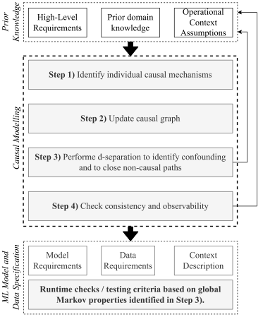
Causal RE workflow
Step 1: Identify individual causal mechanisms
Step 2: Create / update a graphical causal model (DAG)
Step 3: Use d-separation to identify confounding and close non-causal paths.
Step 4: Check graph consistency and observability of necessary variables.
FSE 2026 · Montréal · 5–9 July 2026
Causal Models as RE activity
5

Slide 7
Section 4
CONTINUE HERE MONDAY :)
FSE 2026 · Montréal · 5–9 July 2026
Causal Models as RE activity
2

Slide 8
Section 4
BACKUP
FSE 2026 · Montréal · 5–9 July 2026
Causal Models as RE activity
2

Slide 9
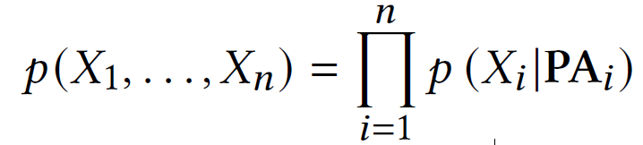
Causal factorisation and d-separation
A DAG also provides us with a causal factorisation, where $${PA}_{i}$$ denotes the set of parents:
d-separation is a graphical criterion for conditional independence.
If variables X and Y are d-separated by Z, then X ⊥ Y | Z,
Used to block non-causal paths (e.g., confounding),
Enables reasoning about what needs to be measured to learn causal effects and not spurious correlation.
FSE 2026 · Montréal · 5–9 July 2026
Causal Models as RE activity
4

